Slide 1
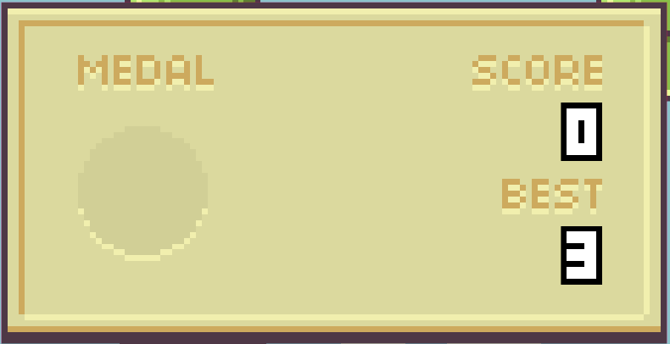






START
REPLAY
HOME
TEXT

Slide 2






Slide 3




Slide 4


